Slide 1

Table of Content
Machine Learning – Ames House Prices - Advanced Regression Techniques

Slide 2
Overall Workflow
Background
Exploratory Data Analysis (EDA)
Data Engineering
Data Modeling & Model Selection
Conclusion & Recommendation

Slide 3
Background

Slide 4
Background
The Objective of this project is to utilize the dataset to
To perform exploratory analysis to gain business insights and describe the patterns between features
To identify most important features that affect house prices
To budget for renovations to increase home value and to boost ROI on home improvement for sale/resale
Target Audience
Sellers/Owners of houses who are looking to sell the property with reasonable and maximized price
Buyers/New comers to Ames who are looking for property with optimized portfolio of attributes
Assumption
To analyze a bundle of attributes of house and the final price assuming it reflects the value of all attributes
Data
2 Datasets (Training and Test data) provided by Kaggle
Covers 5-year data for the period from 2006 to 2010
2580 rows x 81 columns

Slide 5
Exploratory Data Analysis (EDA)

Slide 6
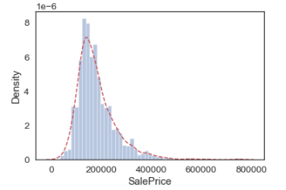
Exploratory Data Analysis (EDA)
Univariate analysis - Analyzing 'SalePrice‘ Self
Count | 1460.000
Mean | 180921.196
Std | 79442.503
Min | 34900.000
25% | 129975.000
50% | 163000.000
75% | 214000.000
Max | 755000.000
Skewness | 1.882876
Kurtosis | 6.536282

Slide 7
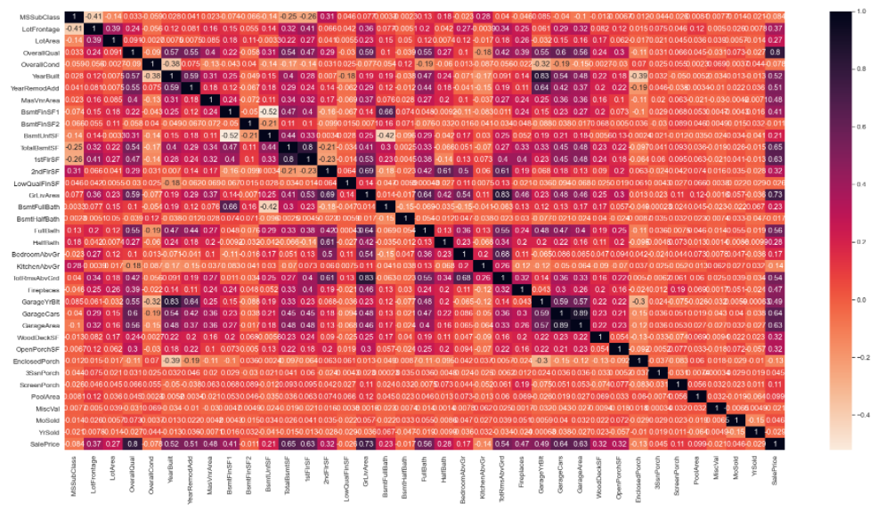
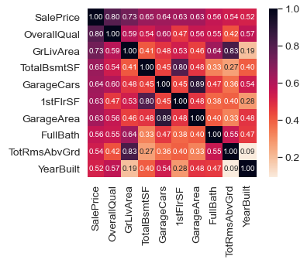
Exploratory Data Analysis (EDA)
Correlation Matrix
Overview Heatmap
Zoomed View
'OverallQual', 'GrLivArea' and 'TotalBsmtSF' are strongly correlated with 'SalePrice‘ while 'YearBuilt' is slightly correlated.
To avoid multicollinearity problem, below 3 highly correlated features
should be removed -
1stFlrSF
GarageArea
TotRmsAvrGrd

Slide 8
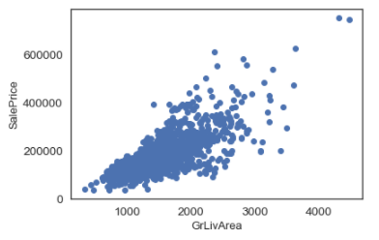
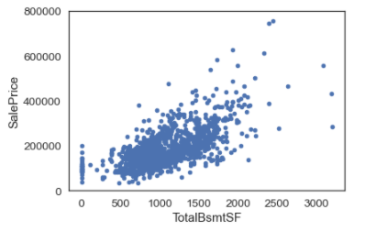
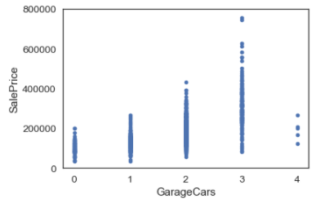
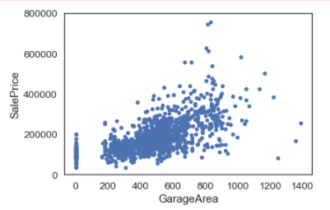
Exploratory Data Analysis (EDA)
Bivariate analysis - Relationship with Numerical Features
HIGHLIGHTS
'GrLivArea‘, 'TotalBsmtSF‘, ‘GarageCar’, ‘GarageArea’ are strongly correlated with 'SalePrice‘.

Slide 9
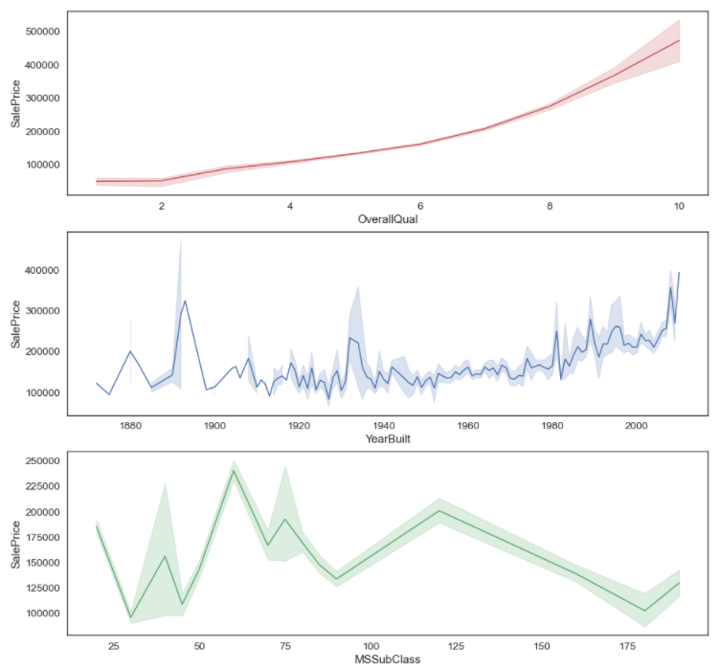
Exploratory Data Analysis (EDA)
Bivariate analysis - Relationship with Categorical Features
HIGHLIGHTS
‘OverallQual’ are highly correlated with ‘SalePrice’
'YearBuilt' and ‘MSSubClass’ are slightly correlated.

Slide 10
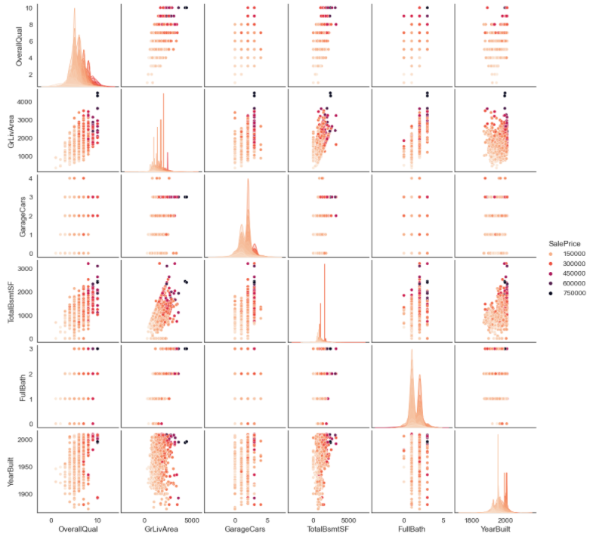
Exploratory Data Analysis (EDA)
Correlation Matrix using SalePrice as Hue base
HIGHLIGHTS
Below 7 features are identified as important features to explore based on EDA -
'SalePrice',
'OverallQual‘
'GrLivArea‘
'GarageCars‘
'TotalBsmtSF‘
'FullBath‘
'YearBuilt'

Slide 11
Feature Engineering

Slide 12
Feature Engineering
Data Consolidation and Cleaning
Consolidation of Train/Test Data
Data Deduplication
Train set size: (1460, 81)
Test set size: (1459, 80)
No duplicates found
Outliers Detection – Isolation Forest
Data Type Update
32 outliers dropped off
Transforming some numerical variables that are really categorical, such as – MSSubclass, OverallCond, YrSold, etc.
Dummify Categorical Features
Encode Categorical Features
# number of features increase from 85 to 222
Ordinal features: use ordinal encoder
Non-ordinal categorical features: use target encoding
Notes:
The next step is deal with data features. For simplicity, I consolidated the train and test data together for further cleaning.
There are no duplicates observation found in the dataset. Using isolation forest, 32 outliers are captured and dropped off.
Then, for some numerical variables that really should be categorical, I transformed into categorical. For some categorical features like exterior quality or kitchen quality, they are enconded into ordinal.
Further more, all categorical features are dummified, leading the total features numbers increased from 85 to 222.

Slide 13
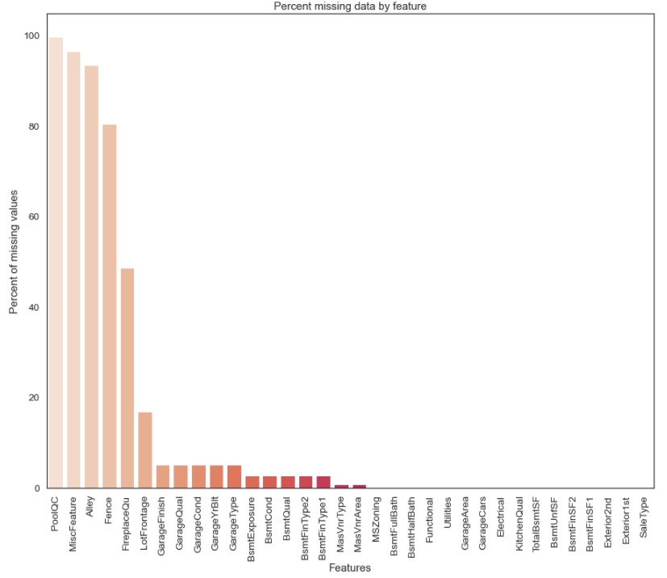
Feature Engineering
Imputing Missing Values based on Designed Rule
Missing values Imputation
Imputation Rule –
Fill in “None” for categorical features, including PoolQC, MiscFeature, Alley, etc.
Fill in 0 for numerical features, including GarageArea, BsmtUnfSF, etc.
Fill in Median value for certain features, including LotFrontage, etc.
Fill in Mode value for certain features, including MSZoning, SalesType, etc.
Fill in “AllPub” for feature ‘Utilities’ as >99% of data are ‘AllPub’.

Slide 14

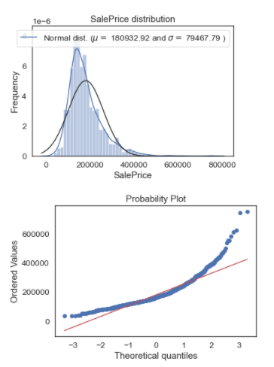
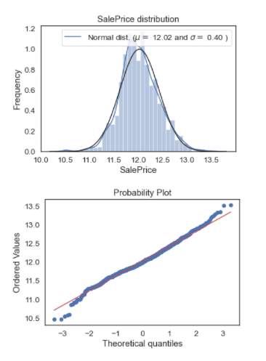
Feature Engineering
BoxCox1P Transformation - Normality
Apply boxcox1p transformation to numeric features with high skew value, including – SalePrice, totalBsmtSF, GrLivArea, etc.
The purpose is to make sure data features follow normal distribution
Features | Skew Value
MiscVal | 22.176
PoolArea | 18.611
haspool | 16.108
LotArea | 13.324
LowQualFinSF | 12.021
3SsnPorch | 11.312
KitchenAbvGr | 4.293
BsmtFinSF2 | 4.138
EnclosedPorch | 4.018
ScreenPorch | 3.959

Slide 15
Feature Engineering
Feature Removal/Creation
Remove useless features / Add new features
Checking VIF – Remove features with VIF > 5
3 Features whose <90% of data are identical are dropped
4 Features with more than 50% null values are removed
Strategically, 9 New Features are added. For instance:
To avoid multi-collinearity, below features should be removed –
Features | VIF
MoSold | 8.264
BsmtFinSF1 | 6.459
BsmtExposure | 6.276
BsmtFinType1 | 5.866
GarageFinish | 4.507
YrSold | 3.426
has2ndfloor | 3.124
LotShape | 3.108
BsmtFullBath | 3.014
HalfBath | 2.766
OpenPorchSF | 2.664
Fireplaces | 2.544
HeatingQC | 2.278
WoodDeckSF | 2.209
MasVnrArea | 2.000
PoolQC (PoolQuality) >99%
MiscFeature (Miscellaneous features not covered) >96%
Alley (type of alley access to property) > 93%
Fence (fency quality) >80%
TotalSF: TotalBsmtSF + 1stFlrSF + 2ndFlrSF
Total_Bathrooms: FullBath + (0.5 * HalfBath + BsmtFullBath + 0.5 * BsmtHalfBath)
Haspool: PoolArea 1 or 0
Has2ndfloor: 2ndFlrSF 1 or 0
Hasgarage: GarageArea 1 or 0
1stFlrSF
GarageCars
TotRmsAvrGrd
MSSubClass
MoSold
BsmtFinSF1
BsmtExposure
BsmtFinType1

Slide 16
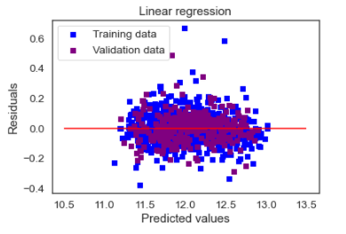
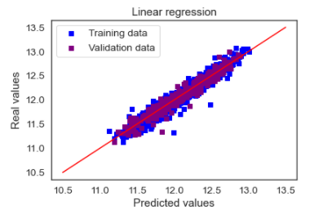
Feature Engineering
Linear Regression Check
Criteria
Normality
Linearity
Constant Variance
Independent Errors
Low MultiCollinearity

Slide 17
Data Modelling
&
Prediction Techniques

Slide 18
Data Modelling &
Prediction Techniques
Major Techniques
Supervised Learning
Cross Validation
With label - SalePrice
5-fold cross validation
Evaluation metrics - (RMSLE) Root Mean Squared Log Error
Multiple Linear Regression
HyperOpt Parameter Tuning
Lasso
Kernel Ridge
Elastic Net
Instead of using GridSearch or Random search, HyperOpt is chosen
Ensemble
Reduced Features Selection
Bagging
Boosting
Stacking
Averaging
Constantly adding features with high importance to
a selection list
10/15/2021
18

Slide 19
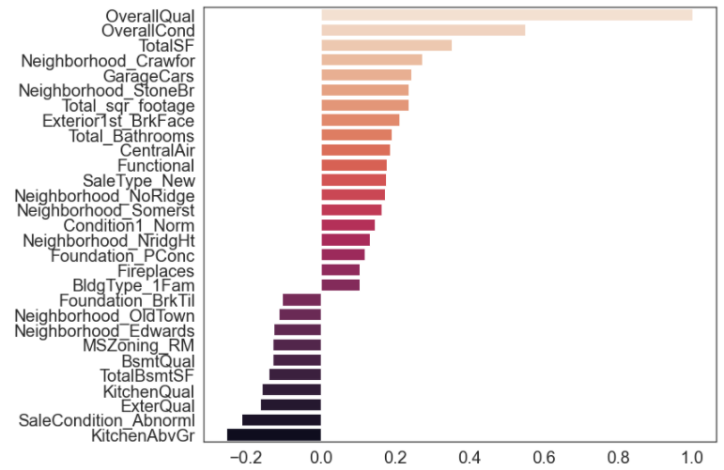
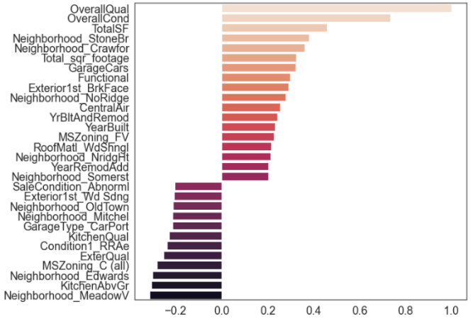
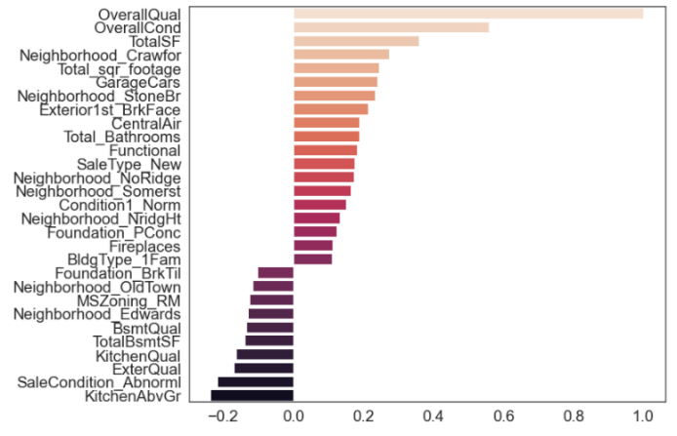
Data Modelling &
Prediction Techniques
Feature Selection based on Importance not equal to 0
1. Penalized Regression Algorithms
Lasso
Kernel Ridge (KRR)
Elastic Net
LassoCV Best Alpha Scored: 0.0006
LassoCV Model Accuracy: 93.08%
Variables Eliminated: 134
Variables Kept: 85
ElasticNetCV Best Alpha Scored: 10.0
ElasticNetCV Model Accuracy: 93.70%
Variables Eliminated*: 146
Variables Kept*: 73
ElasticNetCV Best Alpha Scored: 0.0012
ElasticNetCV Model Accuracy: 93.07%
Variables Eliminated: 131
Variables Kept: 88

Slide 20
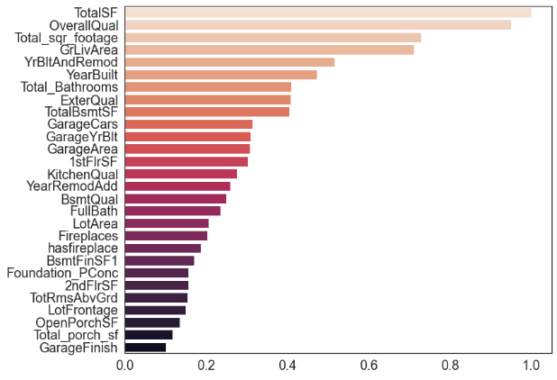
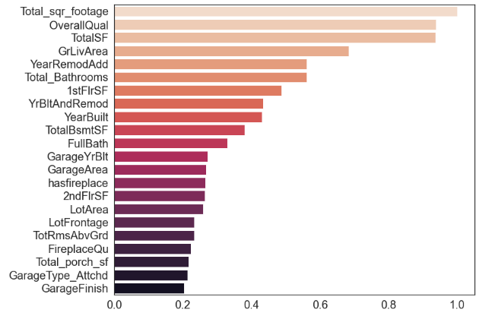
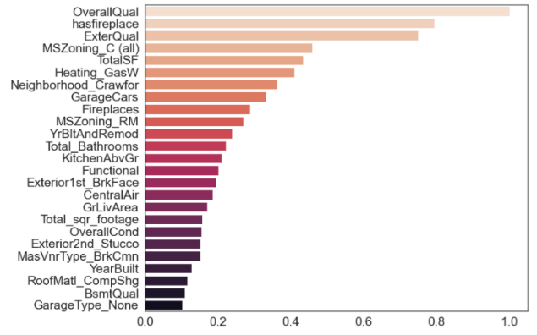
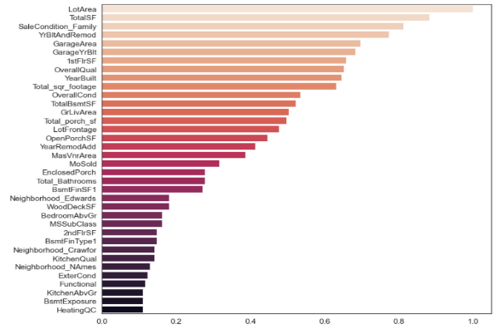
Data Modelling &
Prediction Techniques
Feature Selection based on Importance larger than .1
2. Algorithms based on Bagging/Boosting
Random Forest
GBM
XGB
Light GBM
Random Forest
GBM Regressor
Variables Eliminated: 195
Variables Kept: 24
Variables Eliminated: 185
Variables Kept: 34
Variables Eliminated: 195
Variables Kept: 24
XGBoost Regressor
LightGBM Regressor
Variables Eliminated: 188
Variables Kept: 31

Slide 21
Data Modelling &
Prediction Techniques
Feature Reduced Modeling
Penalized Regression/Bagging/Boosting
Model | MAE% | R^2 Score | RMSLE Mean | RMSLE Std | Rating
Lasso | .066 | .935 | .101 | .007 | Fair
Elastic Net | .066 | .936 | .101 | .007 | Fair
Kernel Ridge | .055 | .955 | .102 | .008 | Fair
Random Forest | .054 | .961 | .123 | .005 | Poor
Gradient Boosting | .022 | .993 | .102 | .006 | Fair
Light GBM | .054 | .957 | .105 | .007 | Fair
XGBoost | .017 | .996 | .100 | .007 | Good
Advanced Ensemble Techniques - ENet, KRR, GBM, Lasso, XGB (Final)
Model | MAE% | R^2 Score | RMSLE Mean | RMSLE Std | Rating
Averaging | .049 | .962 | .097 | .007 | Good
Stacking | .048 | .966 | .096 | .007 | Good

Slide 22
Data Modelling &
Prediction Techniques
Model Section & Evaluation
4. Weighted Averaging Voting Ensembles – Choosing models with best performance
Best Choice - 40% XGBoost, 20% Averaging, and 30% Stacking Averaged model
Using Final Dataset with Reduced Features – 114 Features (including dummuified)
With training data – the final RMSLE Score for the Weight Averaging Model is .094
With test data provided by Kaggle – Kaggle RMSLE Score is .121 (obviously overfitting)

Slide 23
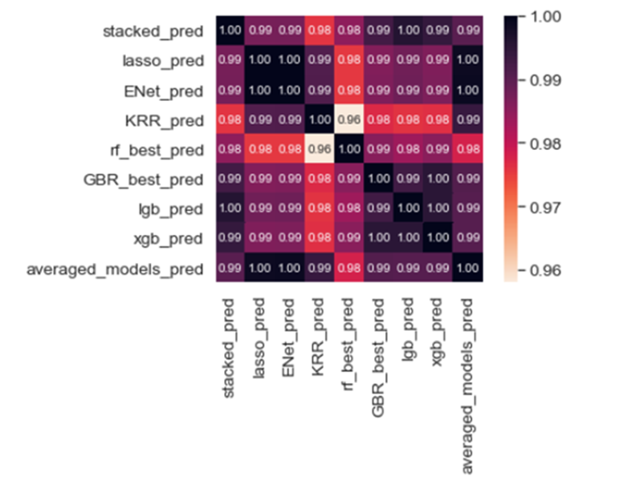
Data Modelling &
Prediction Techniques
Model Section & Evaluation
4. Weighted Averaging Voting Ensembles – Choosing models that are low correlated
Even though most of selected models perform relatively good with low RMSLE scores, it’s still has overfitting problem
Best Choice - 80% XGBoost, 10% KRR, and 10% Stacking Averaged model
Using Final Dataset with Reduced Features – 114 Features
With training data – the final RMSLE Score for the Weight Averaging Model is .096
With test data provided by Kaggle – Kaggle RMSLE Score is .101 (slightly overfitting)

Slide 24
Insights & Recommendation

Slide 25
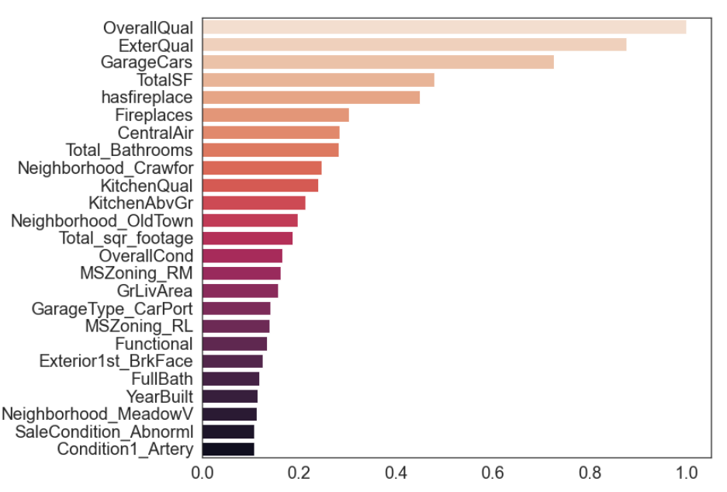
Conclusion & Recommendation
Identification of Important Features in
Housing Research
Based on the analysis, a 60-feature checklist (excluding features) can leveraged as a great tool for Sale Price prediction within 6% MAPE and .10 RMSLE.
Normalization allows a way to compare feature importance across models. After summarization, the most important features are –
Overall Quality
Exterior Quality
Garage Cars/Area
Total Square of Feets
Fireplace
Central Air Condition
# of Bathrooms
Kitchen Quality
Overall condition of the house
Neightborhood in Crawfor, StoneBR, NoRidge,Somerst,and NridgHt are with high premiums
Neighborhood in OldTown and Edwards are with less premiums

Slide 26
Conclusion & Recommendation
Housing Remodeling Budgeting
Features | 1 Unit Change $Dollar Impact based on Lasso Coefficients
OverallQual | 56993.629
OverallCond | 29075.746
TotalSF | 20352.488
KitchenQual | 19713.847
GarageCars | 17945.443
ExterQual | 11623.276
Total_sqr_footage | 11196.114
Exterior1st_BrkFace | 10032.198
SaleType_New | 9834.883
Functional | 9034.701
Total_Bathrooms | 8094.548
CentralAir | 7344.141
Condition1_Norm | 6920.999
Foundation_PConc | 5541.170
Fireplaces | 5405.229
Recommendation for home sellers for house remodeling -
To increase size of garage in car capacity
To upgrade the Kitchen Quality
To improve exterior covering on house with Brick Face
To equip central air conditioning
To increase more bathrooms
To use poured contrete for foundation
To increase number of fireplaces
Recommendation for home buyers when selecting and negotiating a house -
To take overall quality, overall condition, and total
square of feet's as most important attributes when house selection
To understand the impact of Sale Type in housing transaction

Slide 27
Conclusion & Recommendation
What would further to do if given more time, data, etc.?
For feature removing, instead of constantly adding features with high importance to a list, it may be useful to take average weights of each model in the final ensemble when feature selection.

Slide 28
Thank you!

